Slide 1



KS3 Mathematics
S4 Rotation Symmetry
Notes:
The aim of this unit is to teach pupils to:
Use coordinates in all four quadrants
Understand and use the language and notation associated with reflections and rotations
Recognise and visualise transformations and symmetries of 2-D (and 3-D) shapes
Material in this unit is linked to the Key Stage 3 Framework supplement of examples pp 202-211, 218-219.

Slide 2


Rotational symmetry
An object has rotational symmetry if it fits exactly onto itself when it is turned about a point at its centre.
The order of rotational symmetry is the number of times the object fits onto itself during a 360° turn.
If the order of rotational symmetry is one, then the object has to be rotated through 360° before it fits onto itself again.
Only objects that have rotational symmetry of two or more are said to have rotational symmetry.
We can find the order of rotational symmetry using tracing paper.
Notes:
Discuss what it means for a shape to have rotational symmetry.

Slide 3


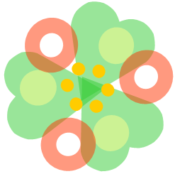
Rotational symmetry
What is the order of rotational symmetry for the following designs?
Rotational symmetry order 4
Rotational symmetry order 3
Rotational symmetry order 5
Notes:
Decide on the order of rotational symmetry before revealing the answer.

Slide 4
Finding the order of rotational symmetry
This shape has rotational symmetry of order 6 because it maps onto itself in six distinct positions after rotations of 60° about the centre point.
How can you prove that the central shape in this diagram is a regular hexagon?
Notes:
Ask pupil how they can prove that the shape in the centre is a regular hexagon using the properties of rotational symmetry.

